Slide 1
Capstone Option 2: Biodiversity for the National Parks
Submitted by George Breen

Slide 2
A section describing the data in species_info.csv. Be sure to include some (or all) of what you noticed while working through the notebook.
The file is full of data about different species in our National Parks, including:
The scientific name of each species
The common names of each species
The species conservation status
The idea is to investigate if there are any patterns or themes to the types of species that become endangered.
Initial Observations
At first we saw slight difference in the percentages of birds and mammals that fall into a protected category.

Slide 3
A section describing the significance calculations that you did for endangered status between different categories of species.
To see if the difference between the percentages of birds and mammals that fall into a protected category is significant we tested it. Our null hypothesis here is that this difference was a result of chance.
The chi-squared test found a p-value of ~0.688, which means the difference between the percentages of protected birds and mammals is not significant and is a result of chance.
Next, we compared the percentages of protected reptiles and mammals and ran the same chi-squared test, we calculated a p-value of ~0.038, which is significant.
Therefore, we concluded that certain types of species are more likely to be endangered than others.

Slide 4
A recommendation for conservationists concerned about endangered species, based on your significance calculations
Given certain species are more likely to be endangered than others we recommend conversation efforts focus on those more prone to endangerment.

Slide 5
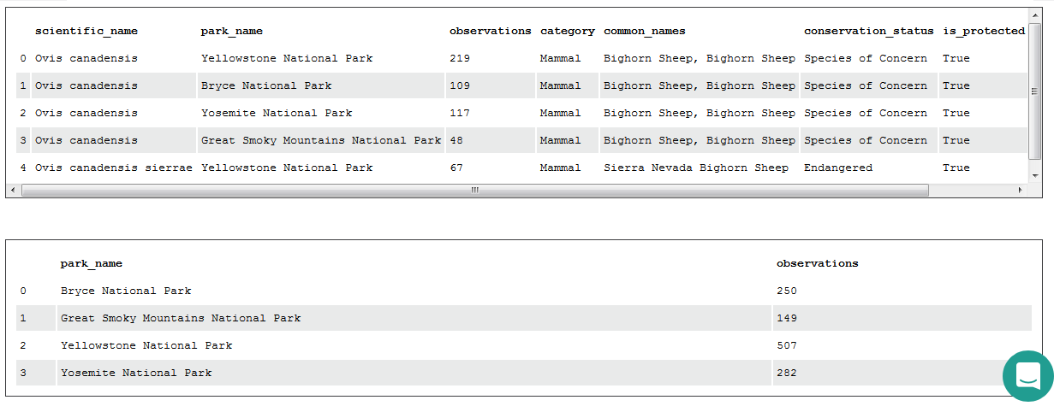
A section describing the sample size determination that you did for the foot and mouth disease study
Conservationists have been recording sightings of different sheep species at several national parks for the past 7 days. We used this data to determine how large of a sample size would be needed.

Slide 6
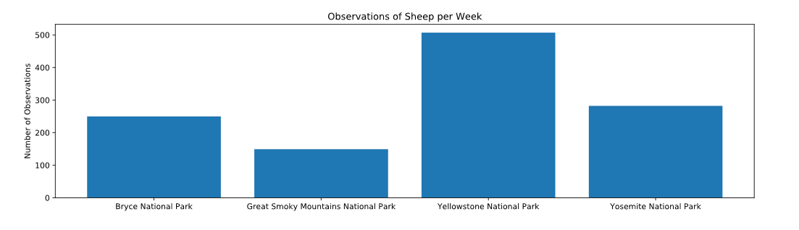
Continued…
Given a baseline of 15% occurrence of foot and mouth disease in sheep at Bryce National Park, if the scientists wanted to be sure that a >5% drop in observed cases of foot and mouth disease in the sheep at Yellowstone was significant they would have to observe at least 870 sheep.
Using the observation data, it would take approximately one week of observing in Yellowstone to see that many sheep, or approximately two weeks in Bryce to see that many sheep.

Slide 7
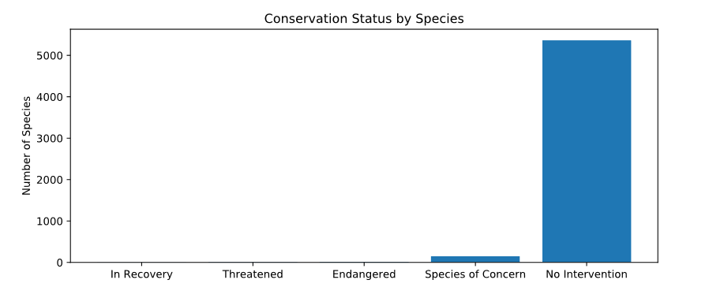
All of the graphs that you created in the notebook

Slide 8
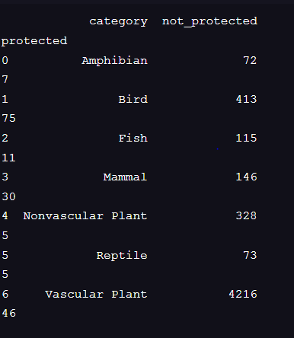
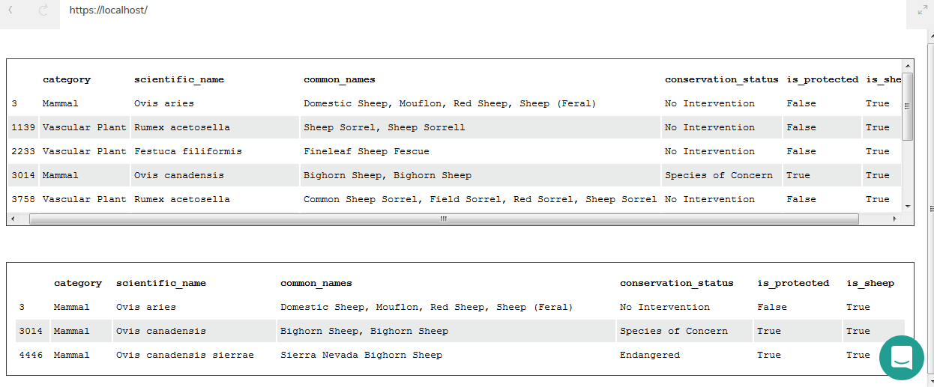
Additional:

Slide 9
Additional:
baseline = 15
minimum_detectable_effect = 100*5./15
sample_size_per_variant = 870
yellowstone_weeks_observing = sample_size_per_variant/507.
bryce_weeks_observing = sample_size_per_variant/250.

